Slide 1
Data Valorization
Meng Li, Alberto García, Yassmin Zouarhi

Slide 2
Business goal
Business problem:
Business costs
Revenue loss
Safety risks
Business value:
Cost reduction
Increased efficiency and productivity
Risk mitigation
Target users:
Energy providers
Agriculture and farming operations
Logistics, travelling, tourism, etc.

Slide 3
Technical goal
Provide an accurate estimation of the weather
Trane, validate, evaluate method
Search for hyperparameters
Data ordered by date
Validation dataset
2014
2012-2013
2015
Training dataset
Evaluation dataset
Notes:
Seasonal patterns
Short-term and long-term dependencies
Noise and variability

Slide 4
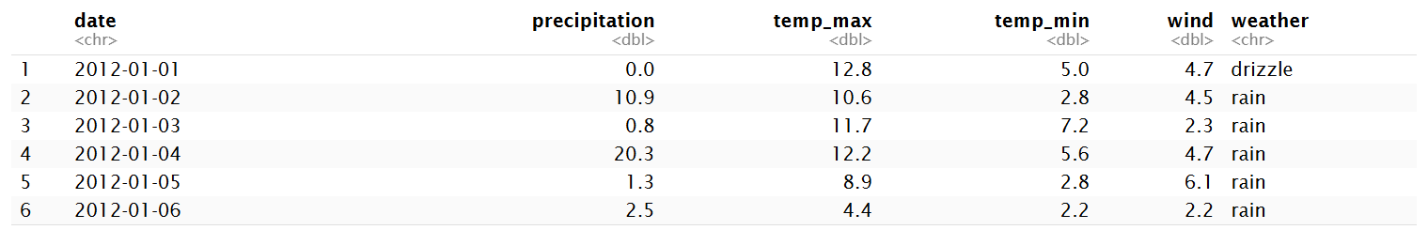
Data description
Dataset name: Seattle Weather
Number of records: 1461 (daily observations)
Quantitative variables:
Date
Precipitation (mm)
Maximum temperature (°C)
Minimum temperature (°C)
Wind speed(km/h)
Qualitative variable:
Weather type
(rain, sun, snow, fog, drizzle)
Our dataset:
https://www.kaggle.com/datasets/ananthr1/weather-prediction

Slide 5
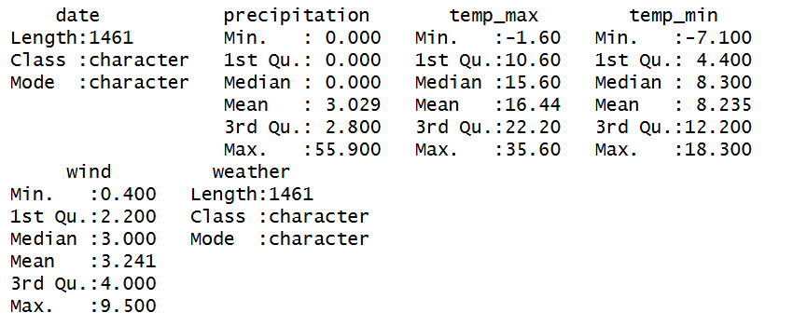
Data quality with univariate analysis
Statistical summary:
The dataset contains 1,461 daily observations
Precipitation is highly skewed, with a median of 0 mm, indicating many dry days
Maximum temperature ranges from −1.6°C to 35.6°C, with an average of 16.4°C
Minimum temperature ranges from −7.1°C to 18.3°C, with an average of 8.2°C
Wind speed shows moderate variability, with a mean of 3.24
The weather variable is categorical and describes daily weather conditions

Slide 6
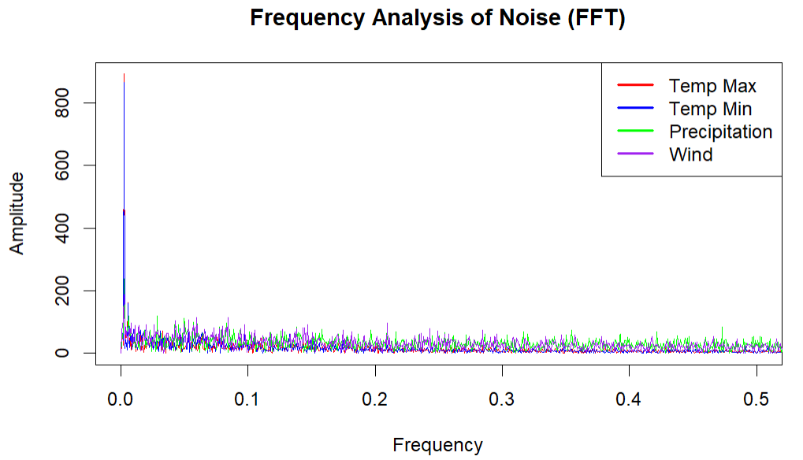
Data quality with univariate analysis
Noise:
This frequency spectrum represents the distribution of noise across different frequencies for each weather variable.
Low-frequency components correspond to slow variations, while high-frequency components represent rapid and irregular fluctuations.
The dominance of high frequencies indicates that the residual variability is mainly random noise rather than structured patterns.
By applying a Fourier Transform to the residuals, we identify whether the unexplained variability is dominated by slow trends or rapid random fluctuations.

Slide 7
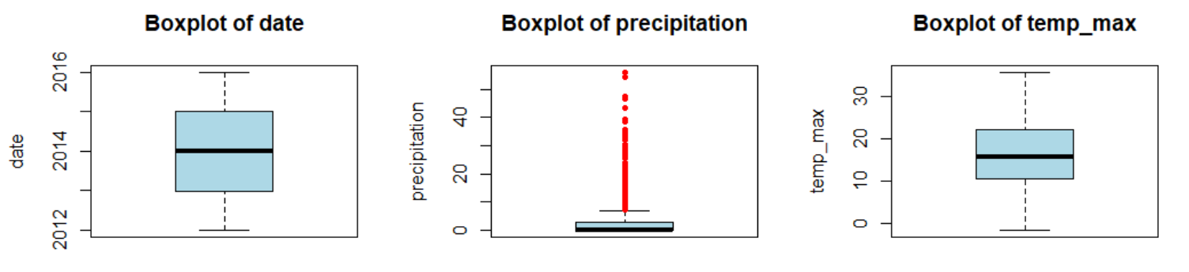
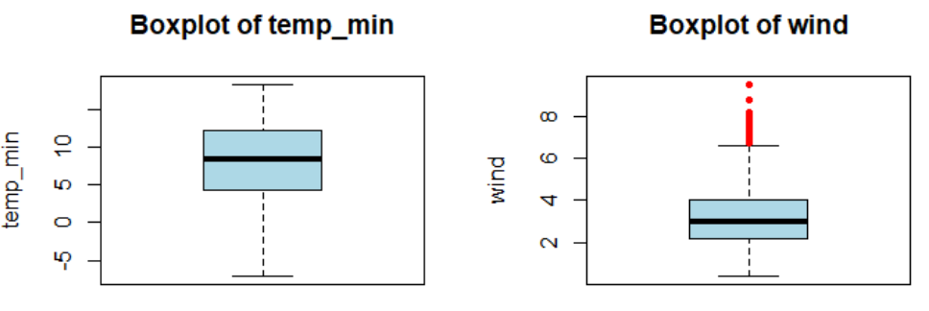
Data quality with univariate analysis
Outliers:

Slide 8
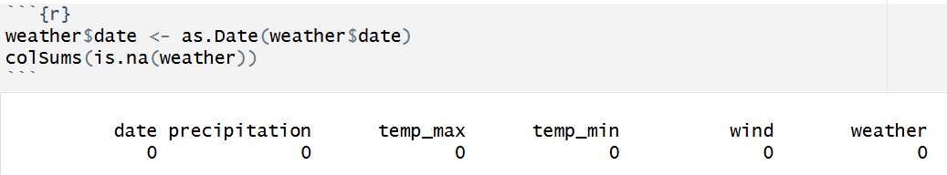
Data quality with univariate analysis
Missing values:
All variables were checked for missing values
No missing values were detected in the dataset
The dataset is complete and ready for analysis
No imputation or data removal was required

Slide 9
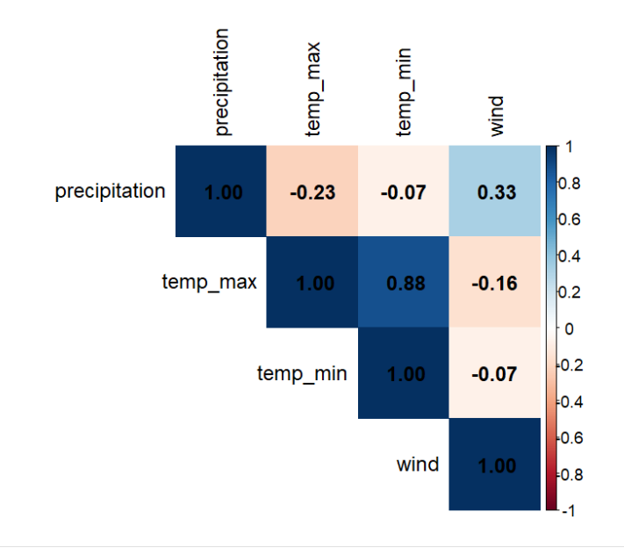
Dependences between the variables
From the correlation matrix heatmap, it can be observed that the maximum and minimum daily temperatures are highly correlated, with a correlation coefficient of 0.88.
In contrast, the minimum daily temperature shows very weak correlations with wind speed and precipitation, with correlation coefficients of −0.07 and values close to zero, indicating that these variables are nearly independent.

Slide 10
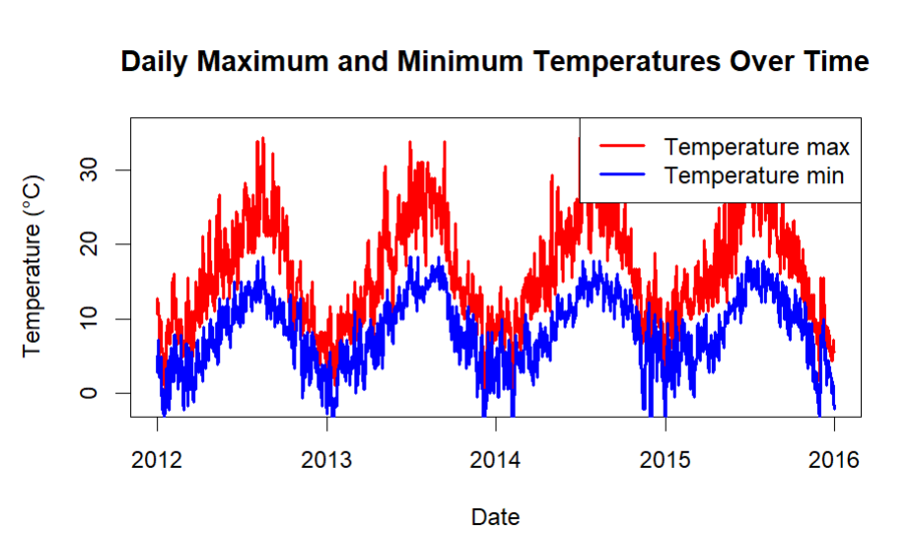
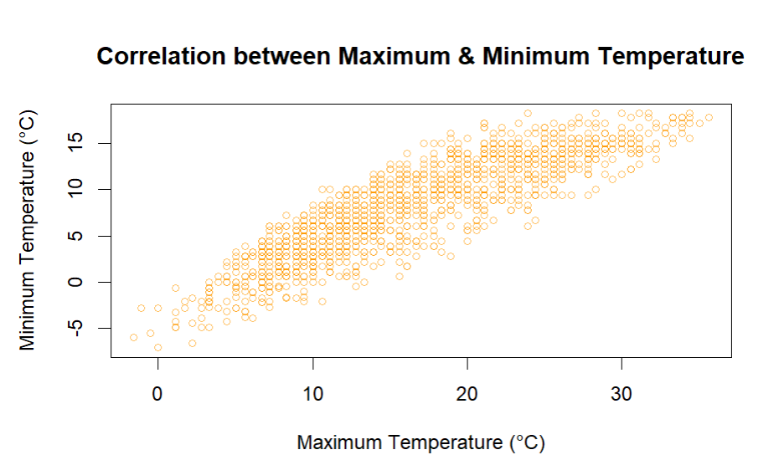
Dependences between the variables
Notes:
From the left-hand plot, it can be clearly observed that the daily maximum and minimum temperatures follow very similar temporal trends, indicating a strong correlation between them. Moreover, both maximum and minimum temperatures exhibit a clear yearly periodic pattern over time. The right-hand figure presents the scatter plot of daily maximum and minimum temperatures. It can be visually observed that the data points roughly align along a straight line, indicating a strong linear correlation between the two variables.

Slide 11
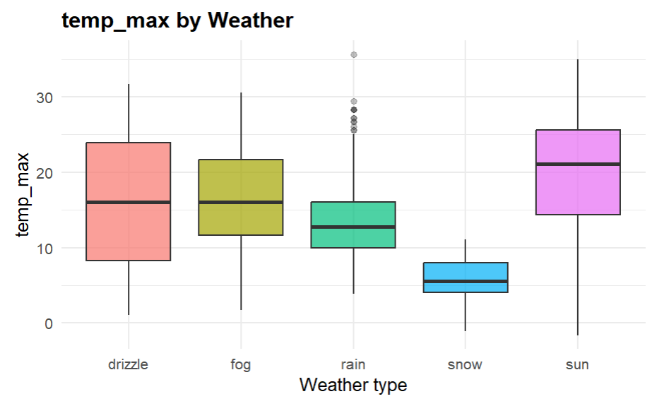
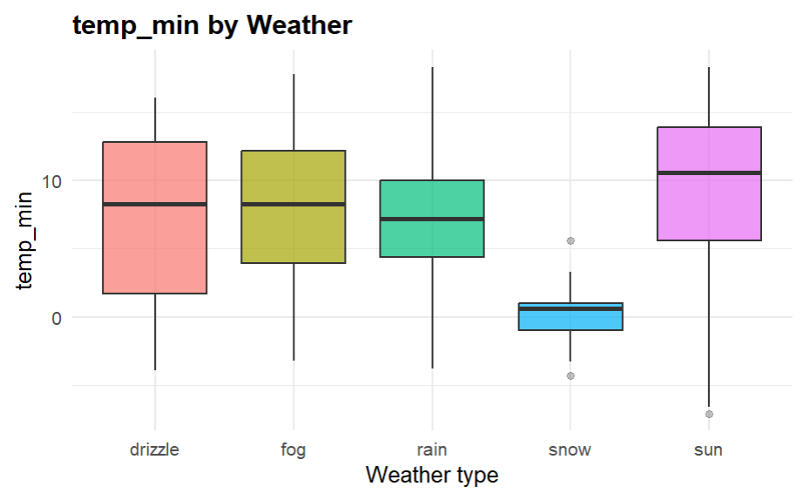
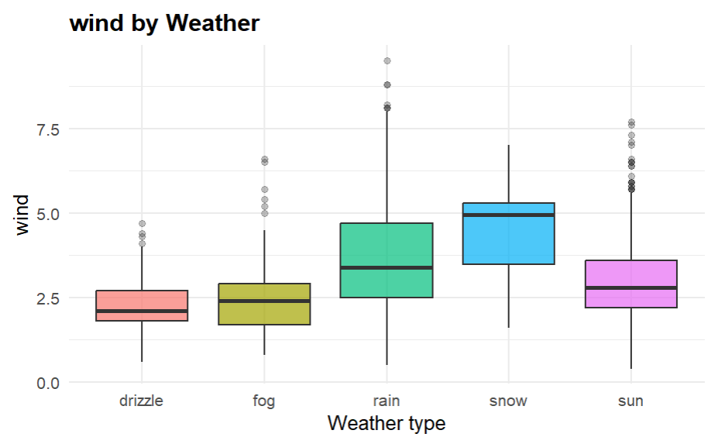
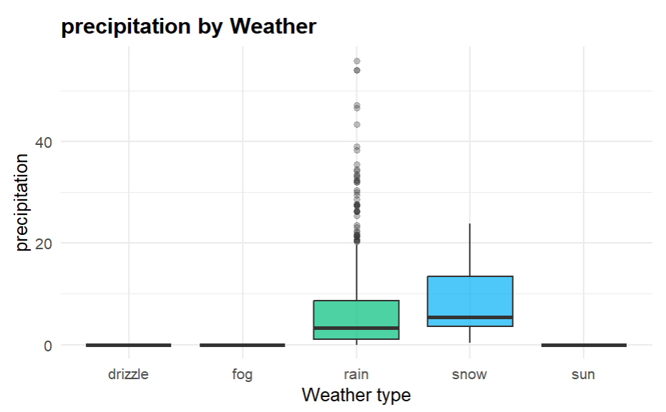
Multivariate statistical analysis of data
Notes:
In order to identify the factors influencing weather conditions, we constructed boxplots to compare each feature across different weather types.
First, we observe that each feature shows noticeable differences across weather categories. This is mainly reflected in the variation of medians, as well as the differences in box heights for maximum temperature, minimum temperature, and wind speed. These patterns clearly indicate that each feature has a strong influence on weather type.
In particular, the boxplots of maximum and minimum temperatures for snowy and sunny conditions do not overlap, suggesting that these two variables can directly distinguish between snow and sun. However, overlaps remain with other weather categories, implying that further discrimination using additional features is necessary.
For wind speed, the value ranges for snow do not overlap with those of drizzle and fog, indicating that wind speed can be used to separate these weather types. Nevertheless, overlaps between drizzle and fog suggest that other variables should be combined for more accurate classification.
Regarding precipitation, only rain and snow exhibit significant values, making precipitation an effective feature to distinguish rainy and snowy conditions from other weather types.

Slide 12
Selection of variables
Last but not least, the final selected variables for our study are maximum temperature, wind speed, precipitation, and date.
From the correlation plot between maximum and minimum temperatures, as well as the boxplots across weather categories, it is evident that these two variables carry very similar information. Therefore, we can select only one of them for further analysis.
Since wind speed and precipitation both show significant influence on weather classification, we remain these two features as well. In addition, temperature exhibits clear seasonal variation over time, so the time variable is naturally preserved.

